Slide 1
Performance Commitment Review

Slide 2
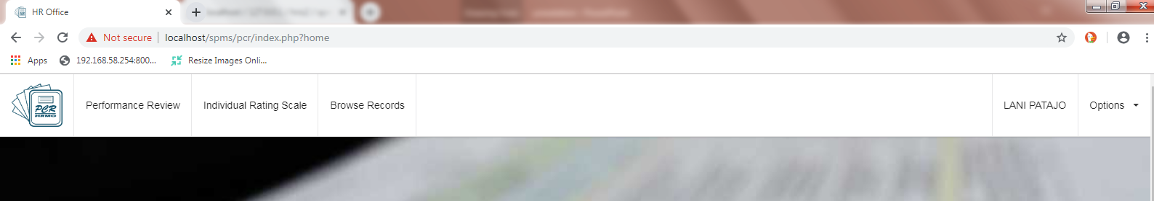
Privileges
Normal

Slide 3
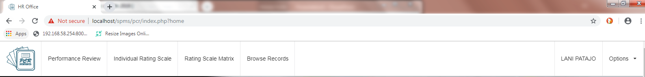
Privileges
Administrative Officer –in-charge of RMS encoding per department

Slide 4
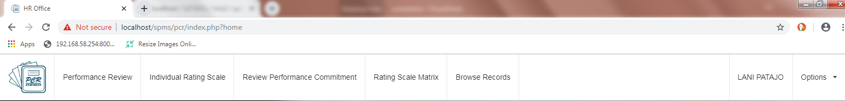
Privileges
Supervisor / Department Head

Slide 5
Mother Scale Matrix Structure

Slide 6
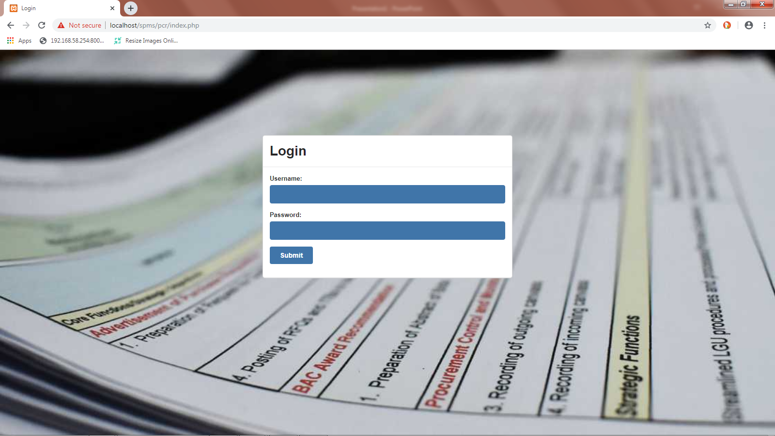


laniPatajo
*********

Slide 7
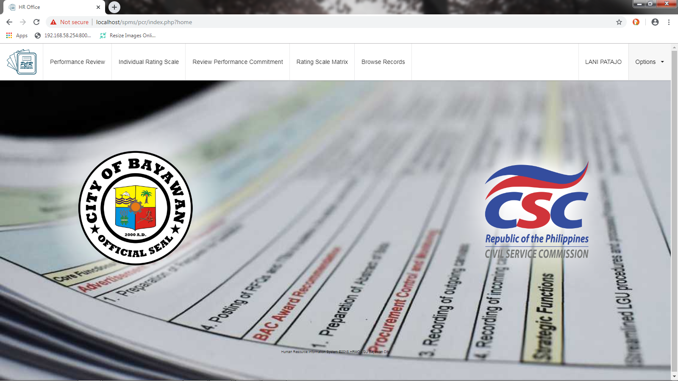

Slide 8
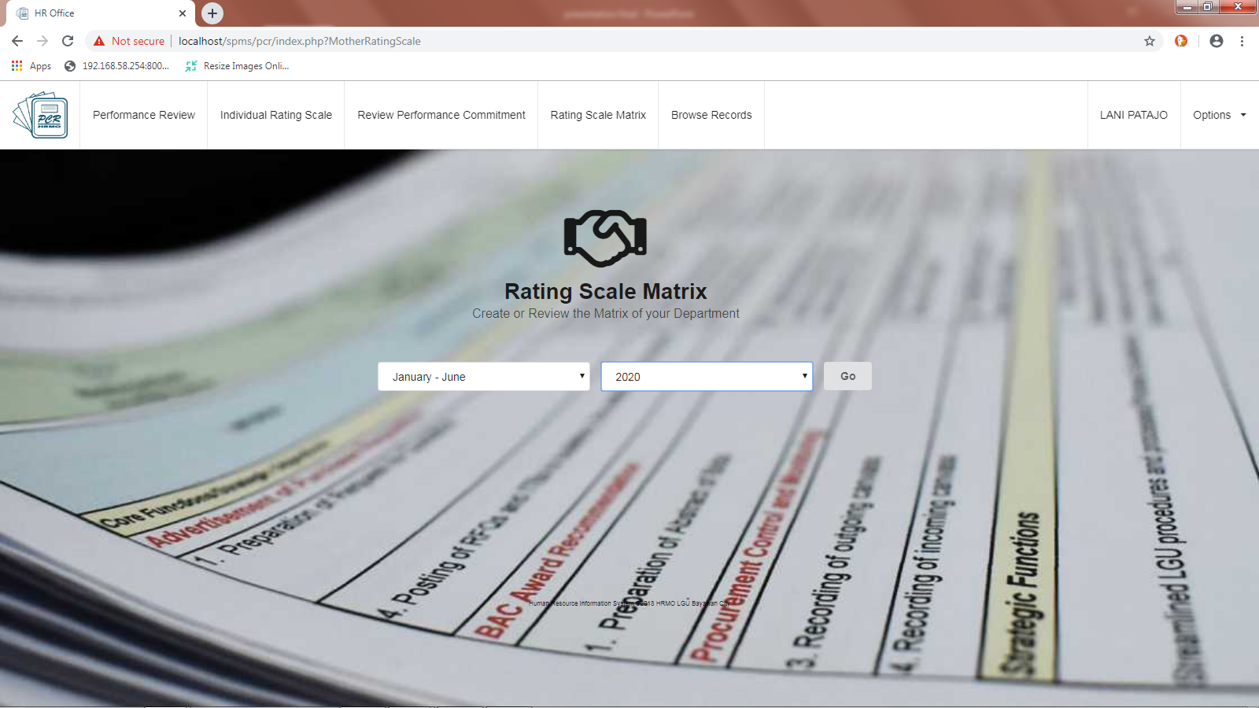

Slide 9
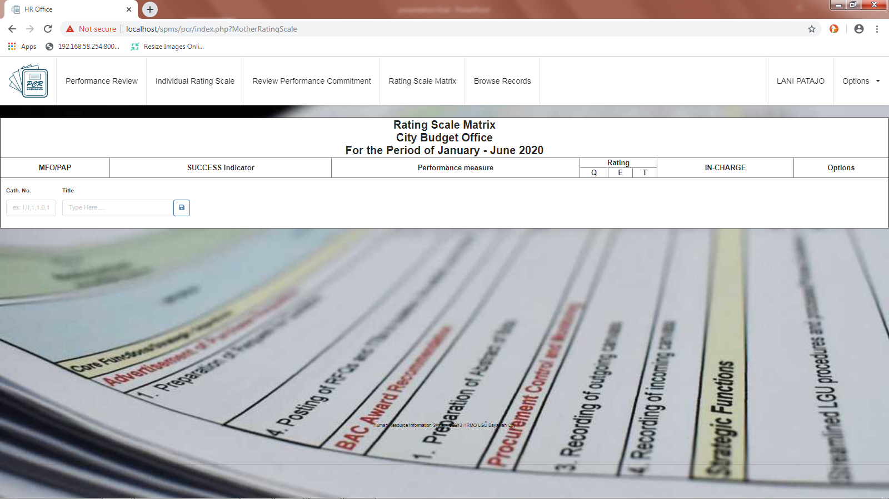
1
BUDGETING PREPARATION

Slide 10
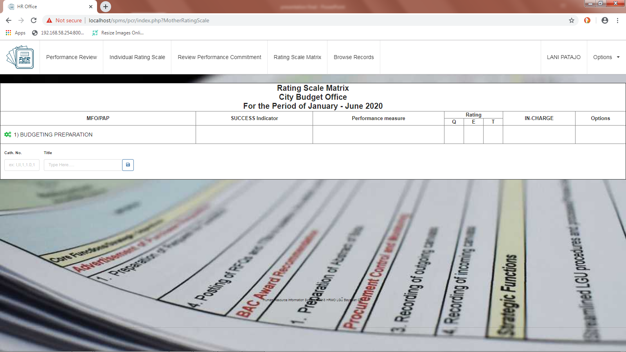

Slide 11
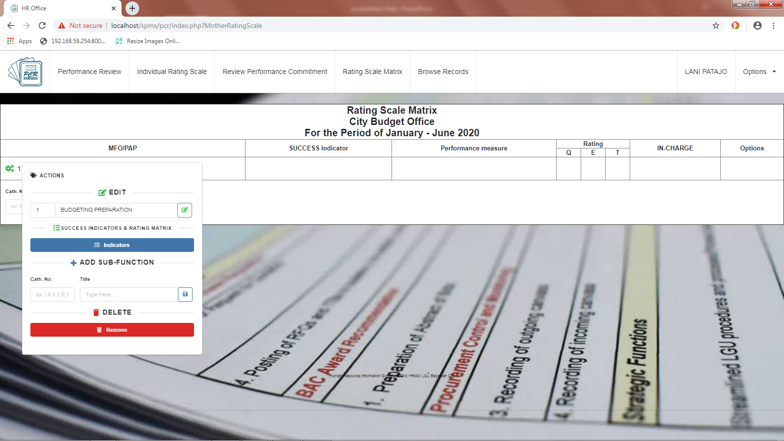
1.1
Annual Budget

Slide 12
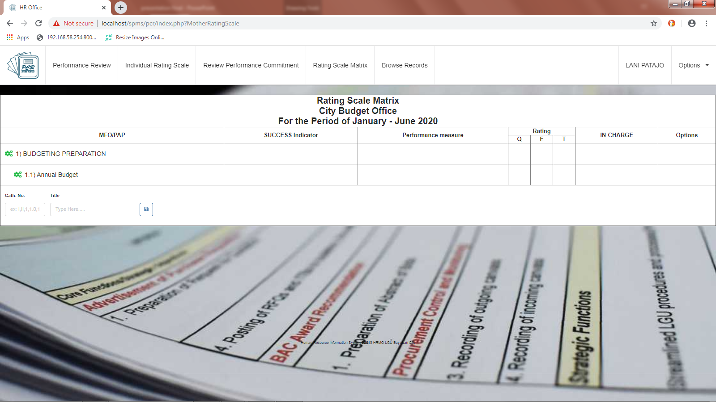

Slide 13
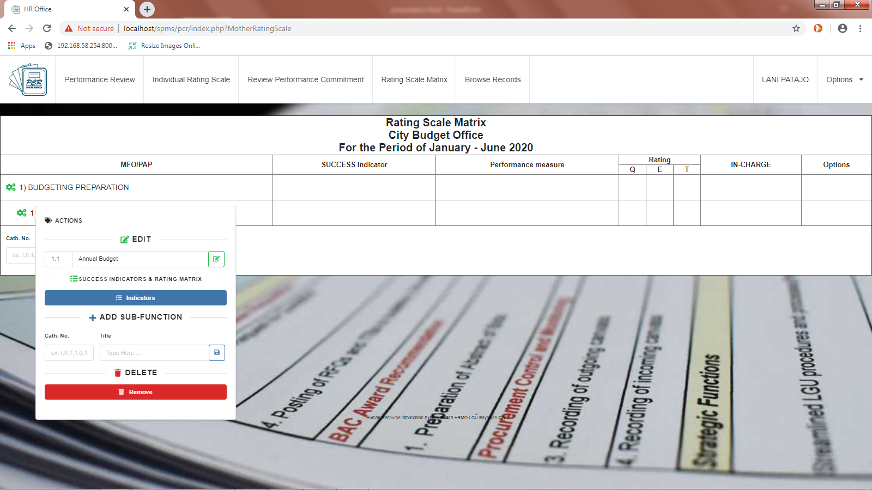

Slide 14
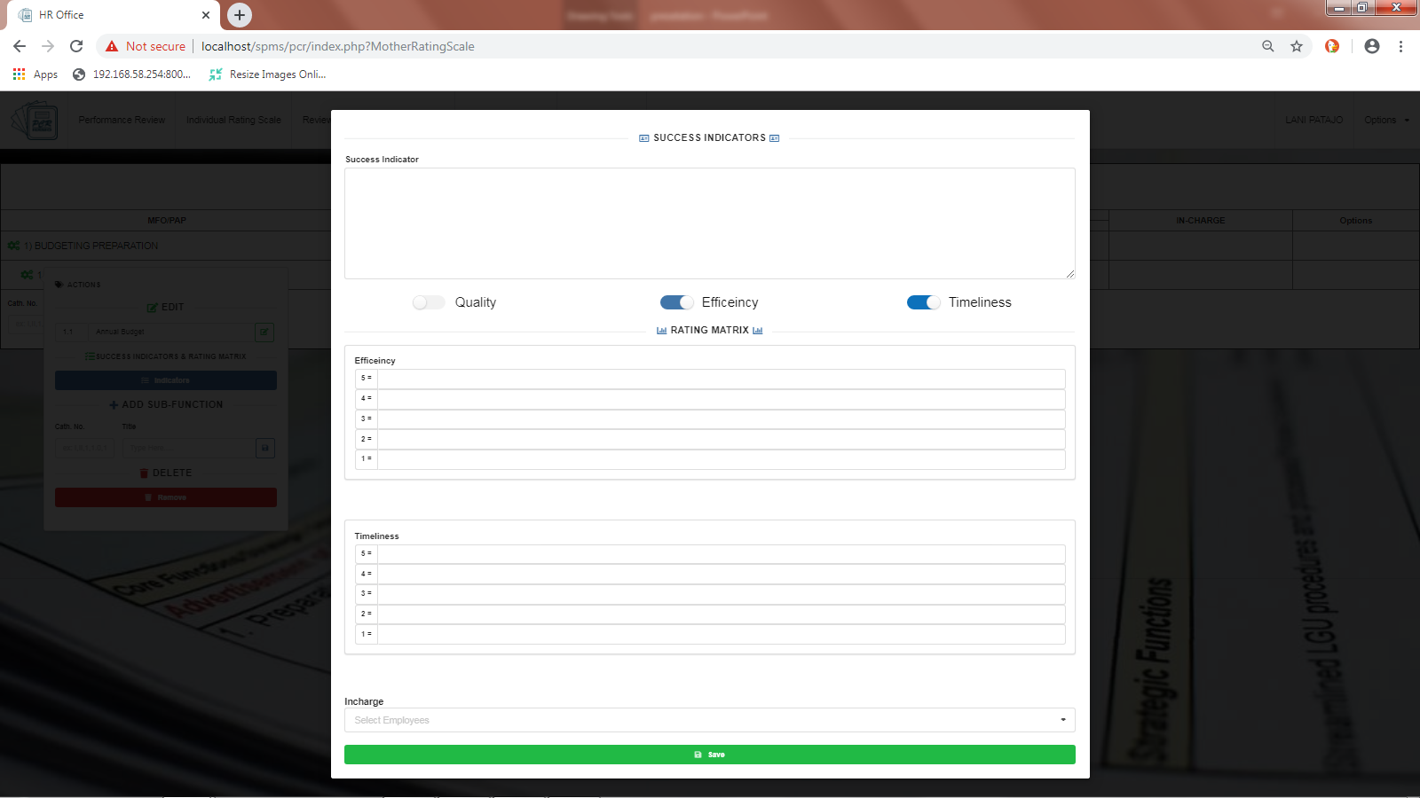
All budgetary requirements & limitations complied
All budgetary Requirements / Limitations complied
1 or more not complied
Submitted on or before deadline
Submitted after deadline
Lani T. Patajo

Slide 15


Slide 16
Performance Review Form

Slide 17
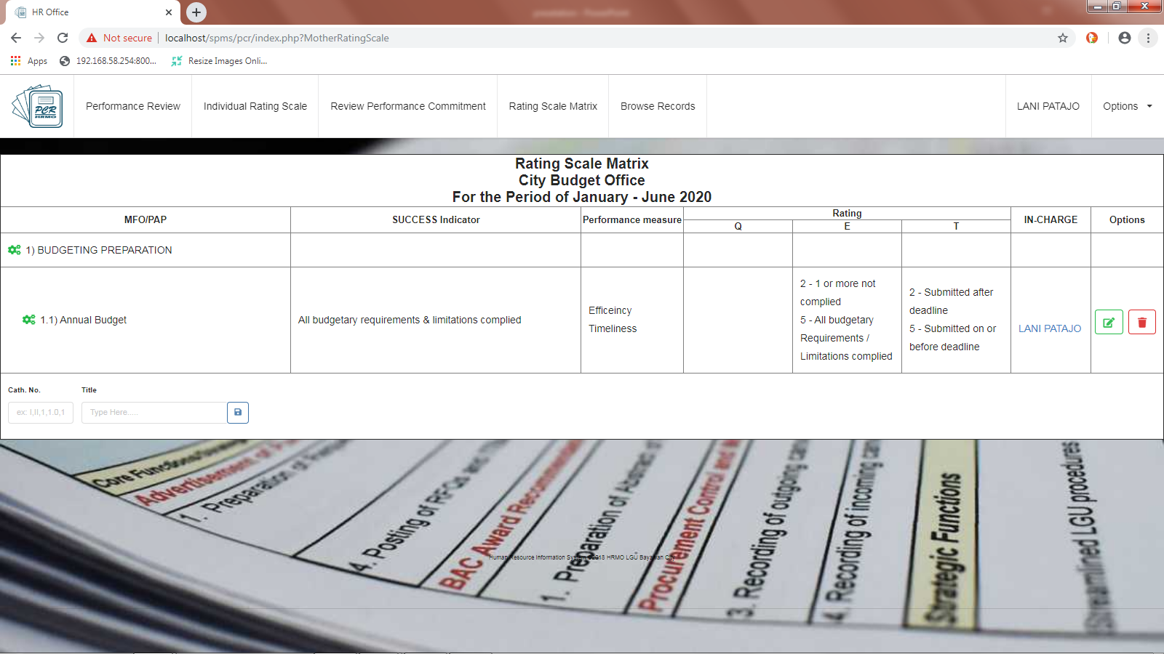

Slide 18
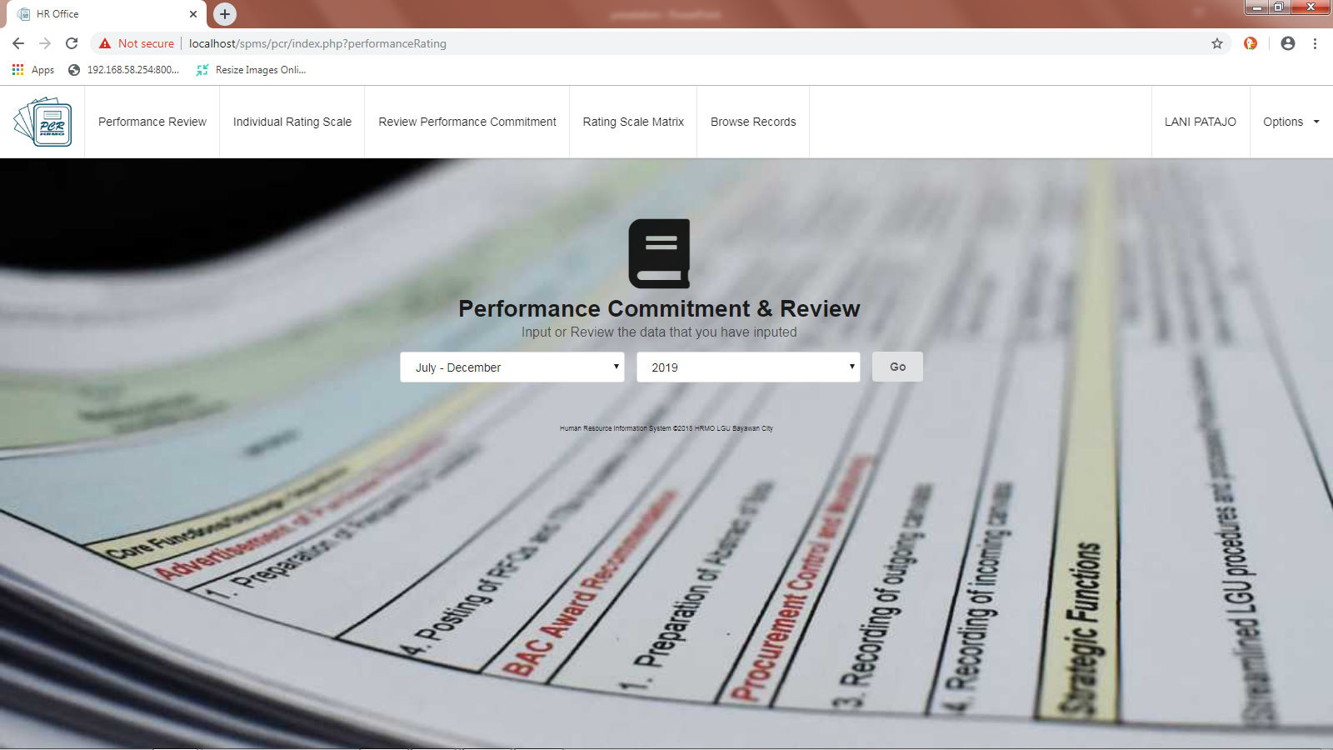

Slide 19
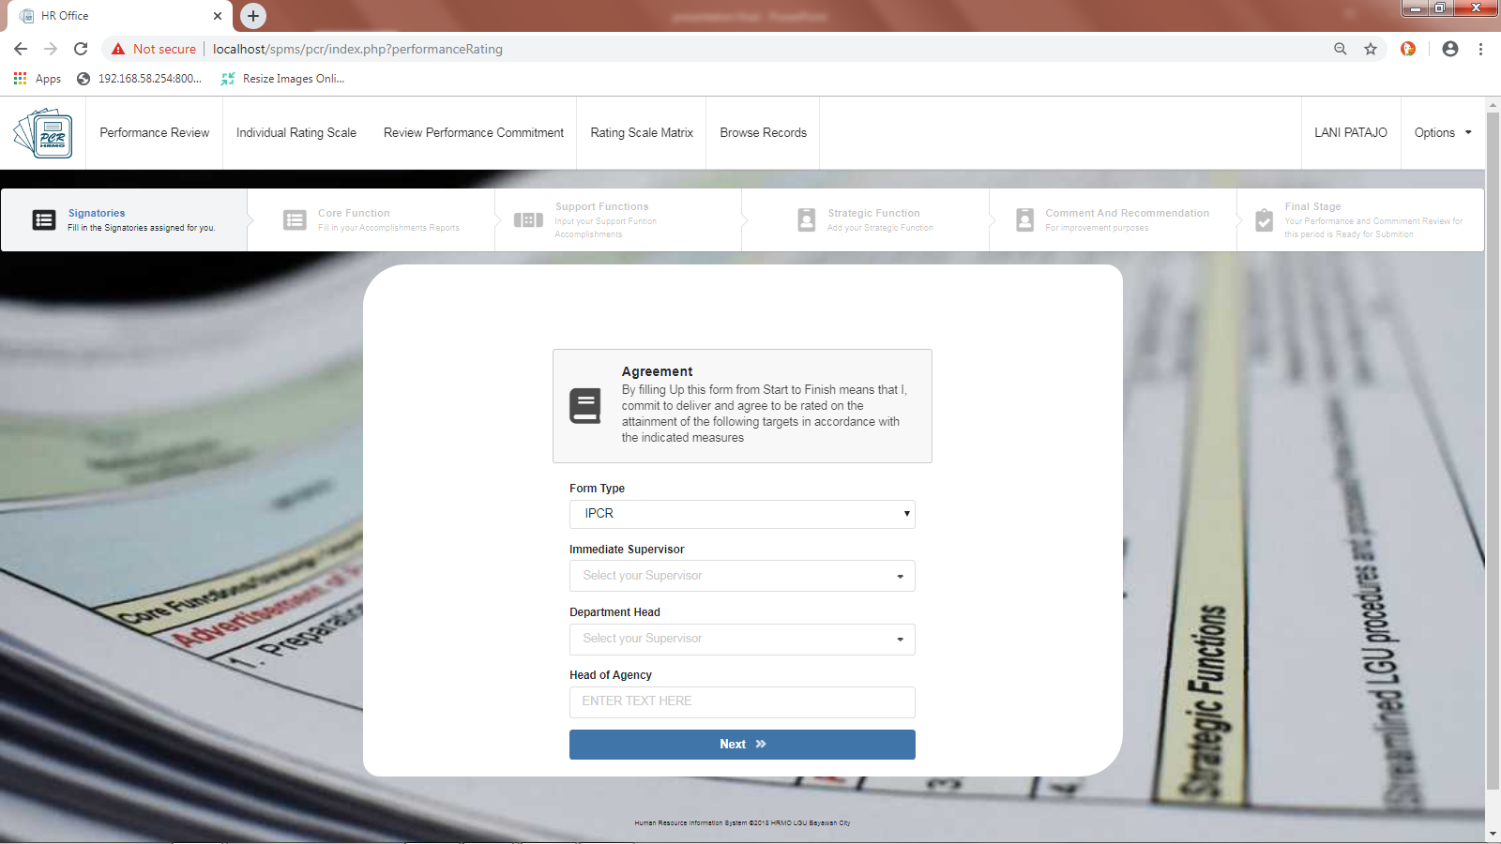

Slide 20
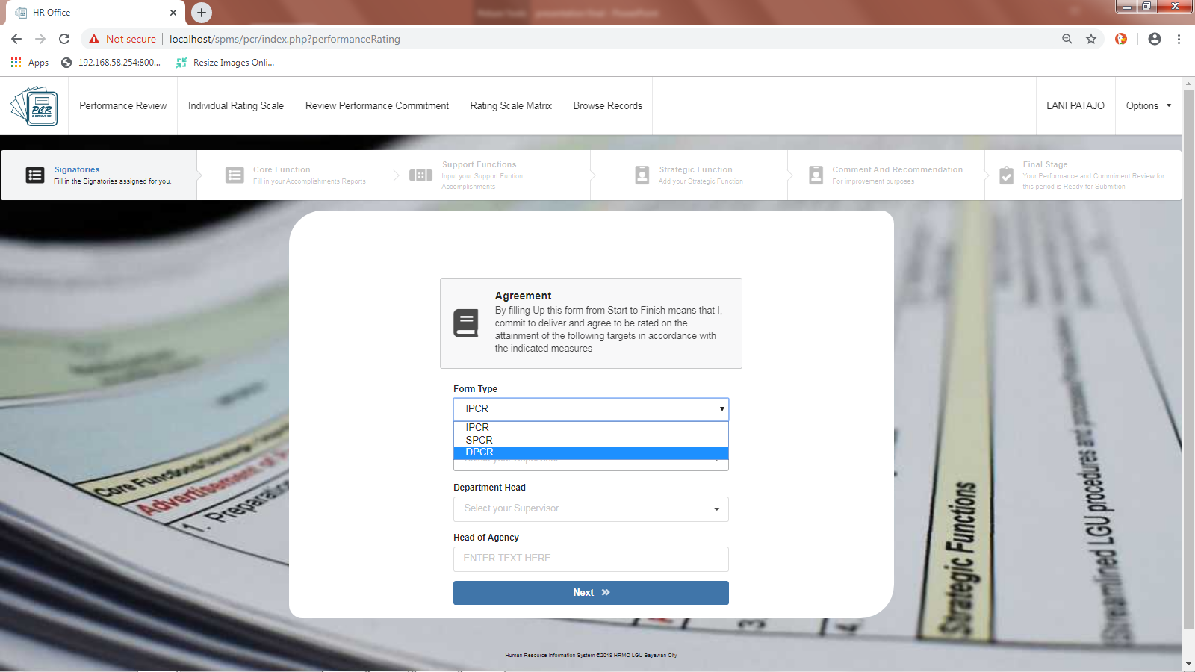

Slide 21

PRYDE HENRY A. TEVES

Slide 22
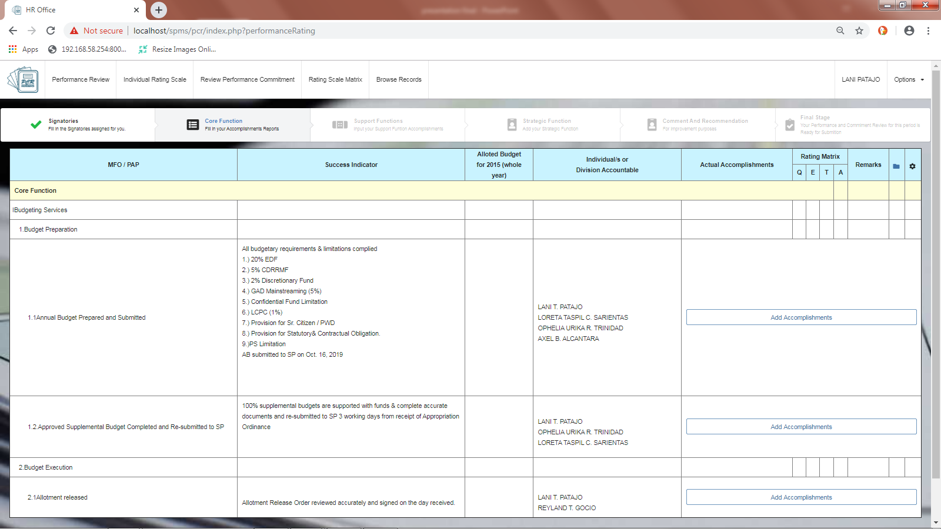

Slide 23
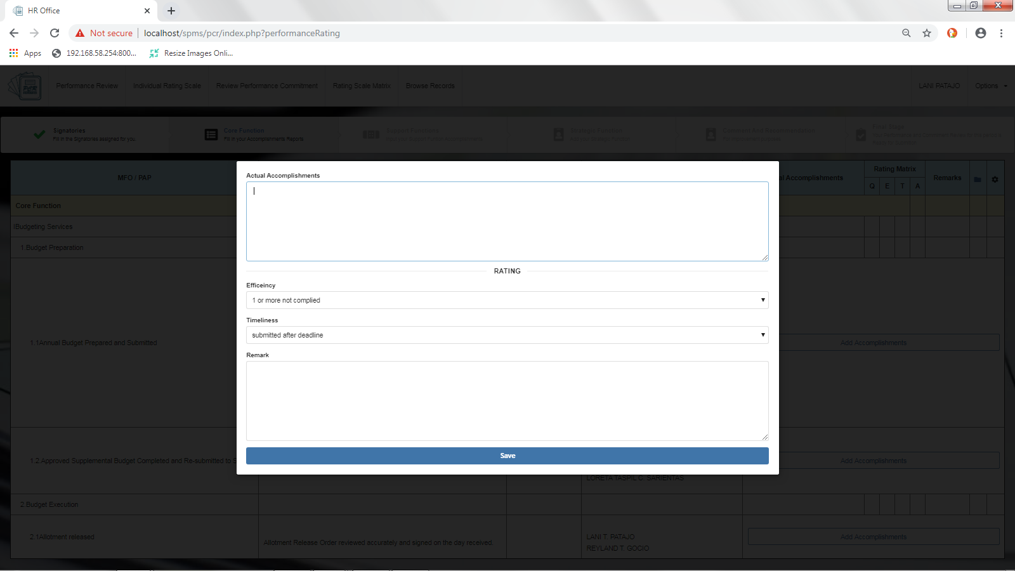
All budgetary requirements & limitations complied

Slide 24
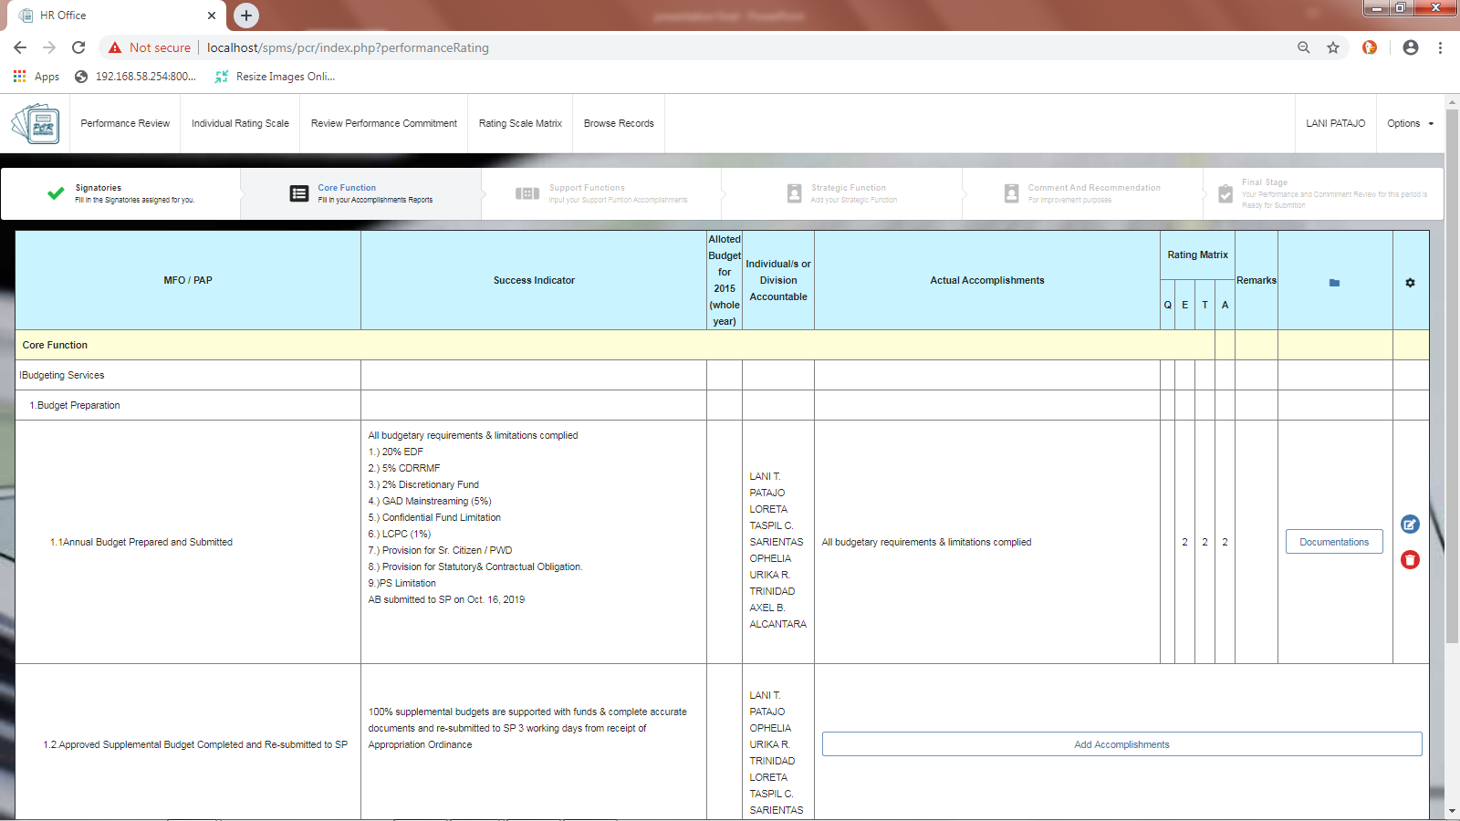

Slide 25
Fill out all the empty core function and it will automatically send you to the next step

Slide 26
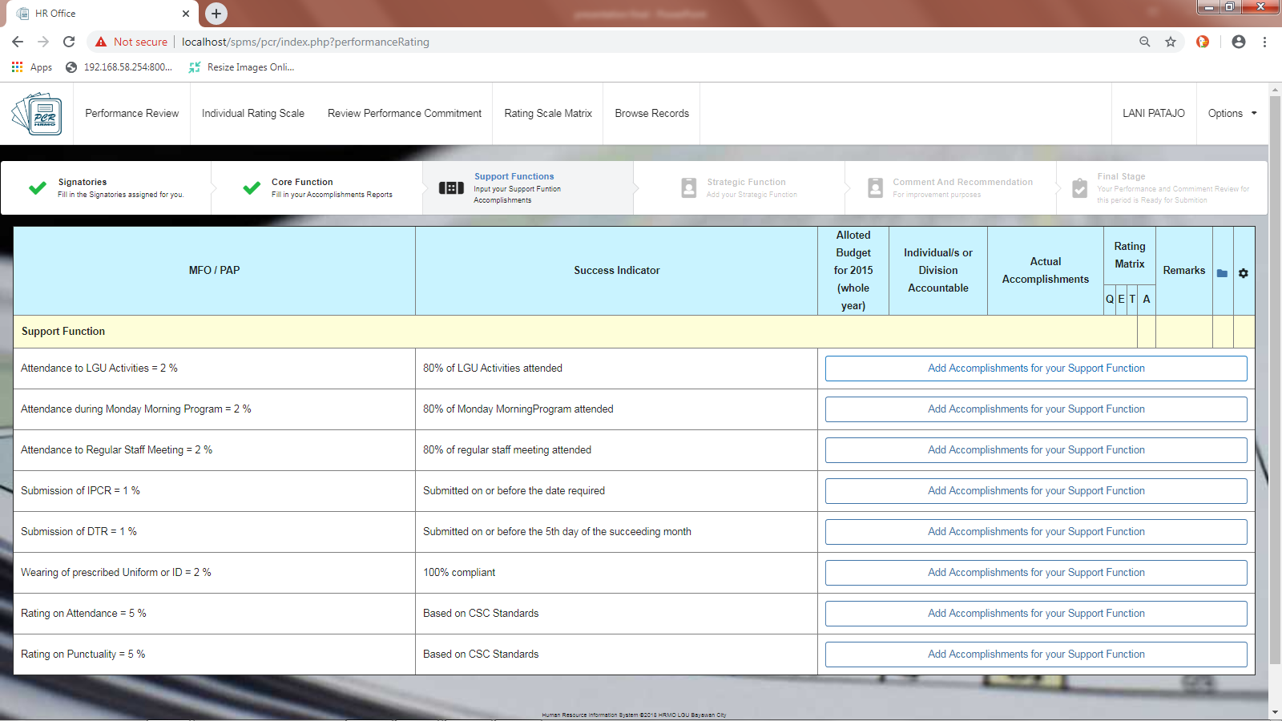

Slide 27
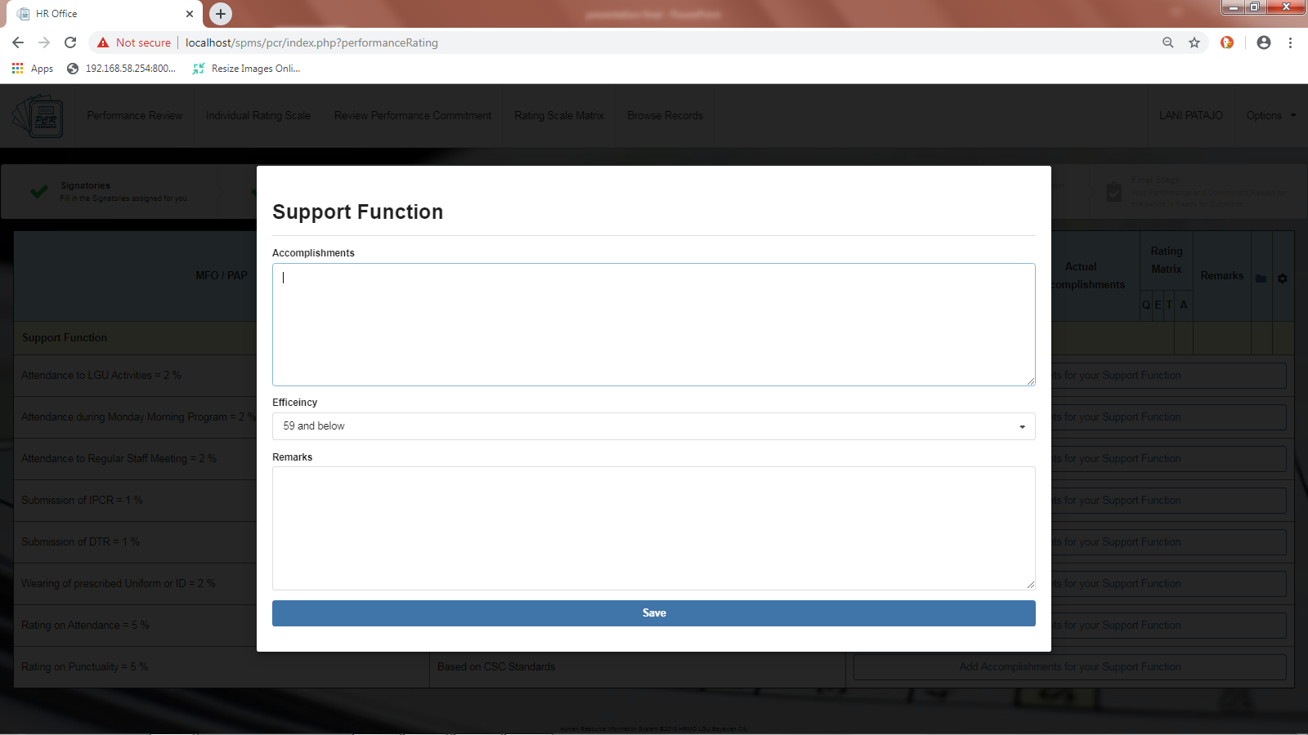
80% of LGU Activities attended

Slide 28
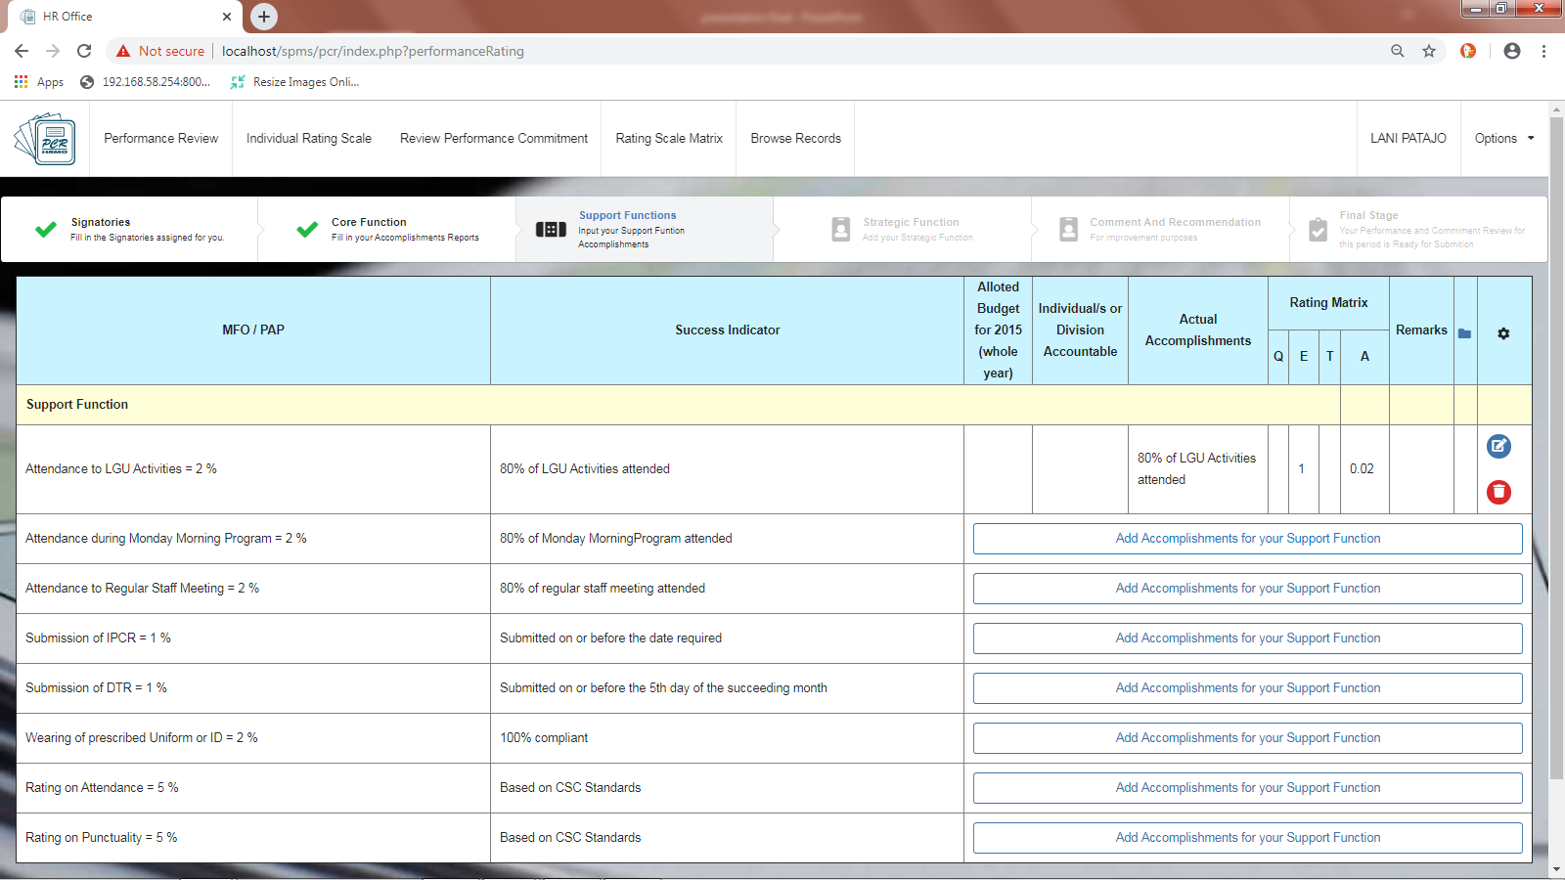

Slide 29
Do it all-over again until all support functions are fill out so you can proceed to the next step.

Slide 30
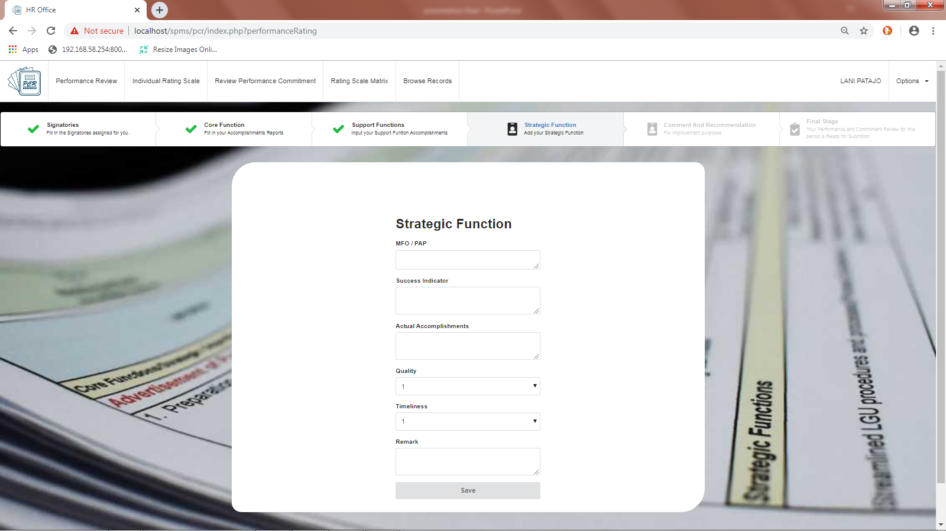
Engage the private sector for commercial production
3 private sectors engaged for commercial production
3 private sectors engaged for commercial production

Slide 31
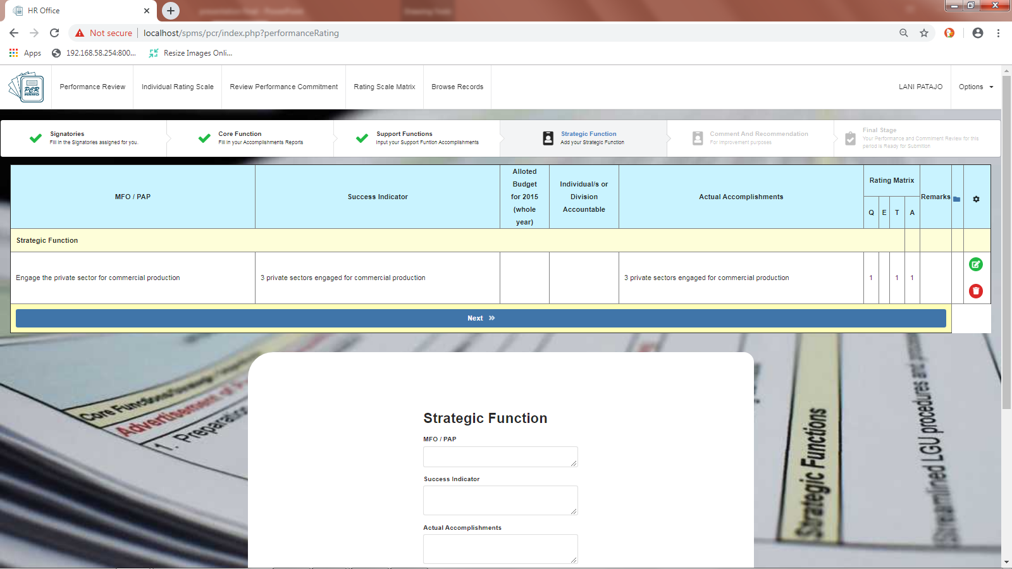

Slide 32
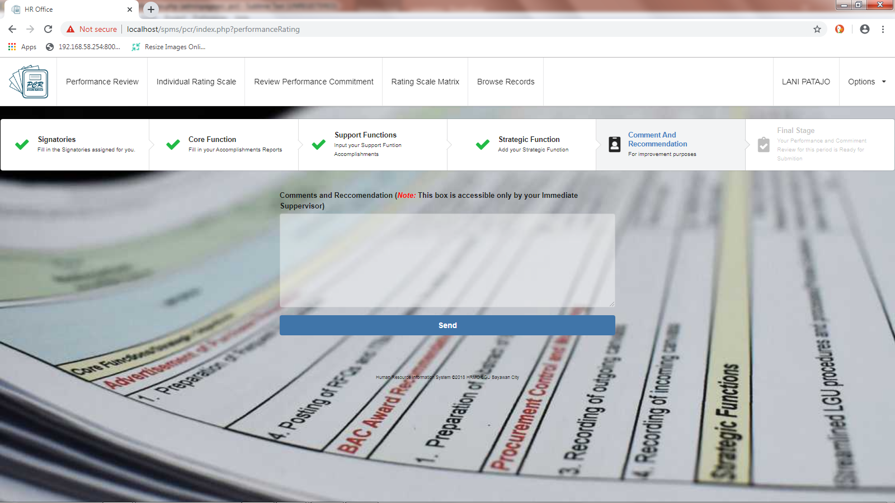

Slide 33
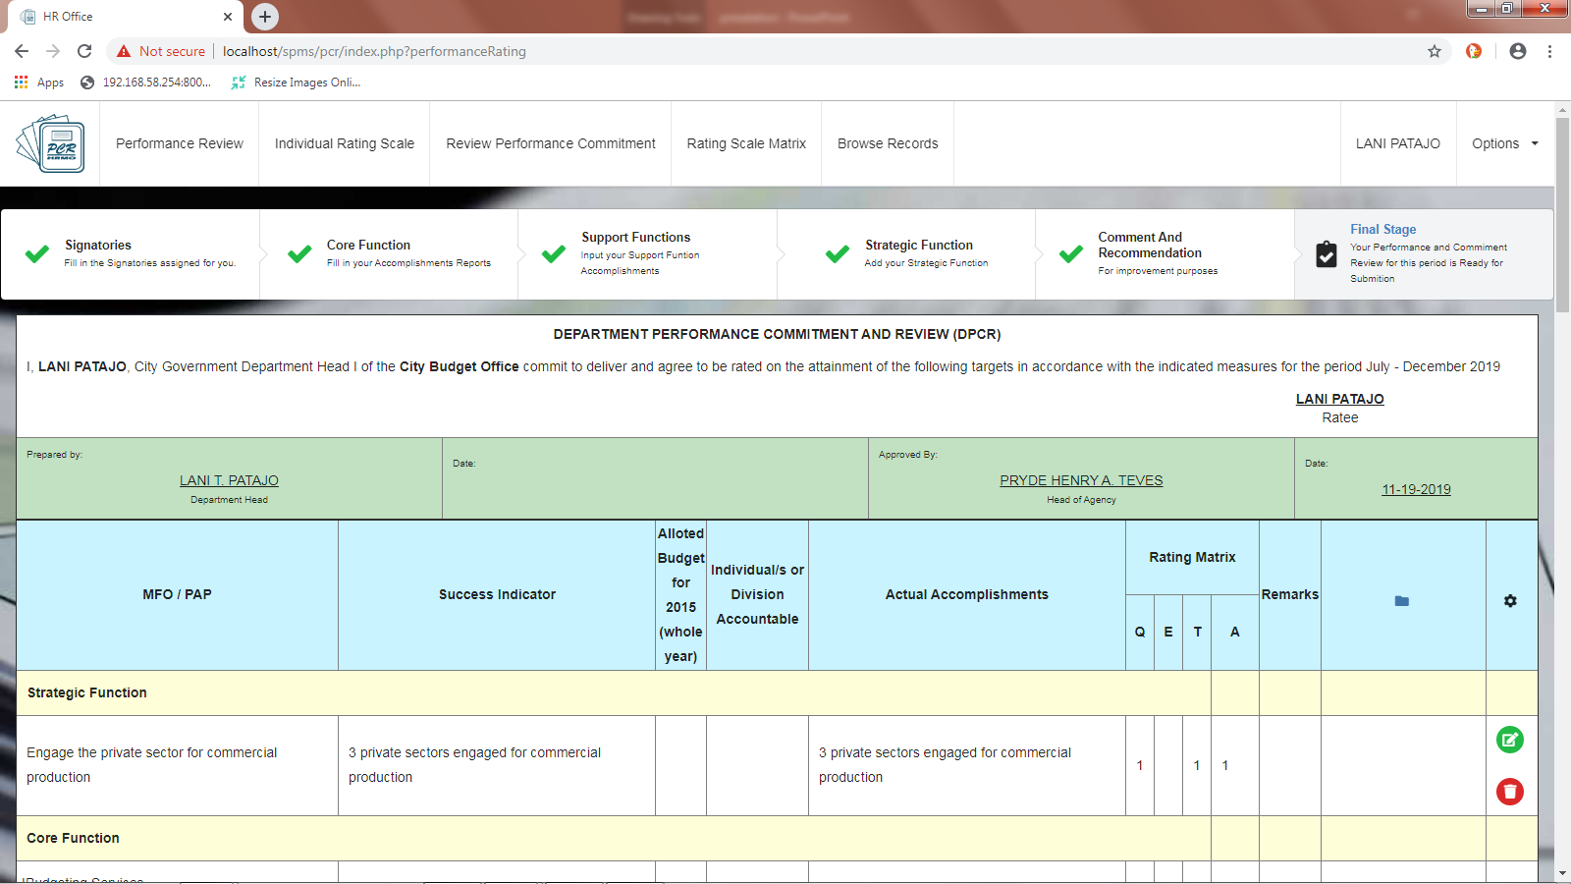

Slide 34
Done

